Slide 1

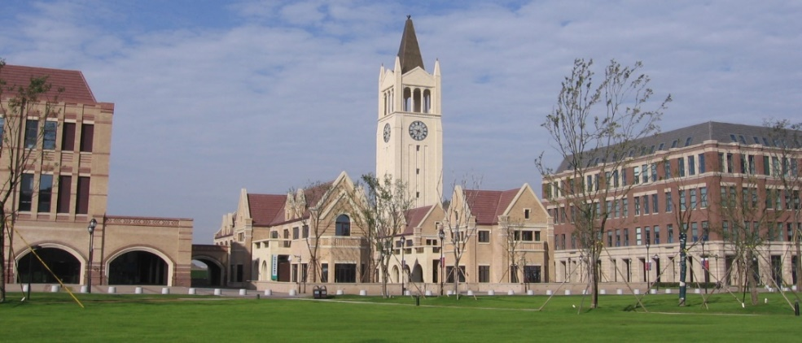

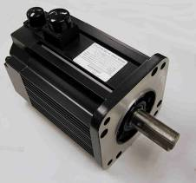
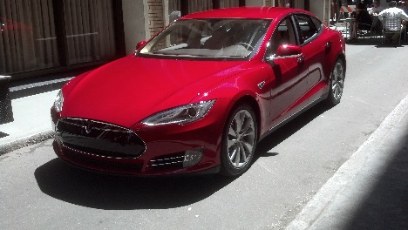
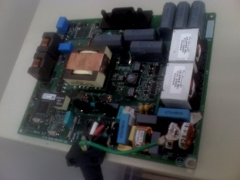
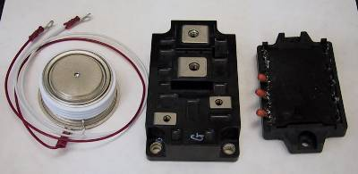
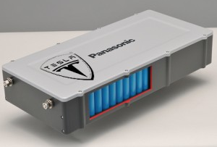

Preparation for graduate study in the U.S.:
The concepts and the application
P. T. Krein
Professor

Slide 2
Early Career Planning
Are there topics of special interest to you?
Are there topics that you would like to learn more in depth?
For any job or graduate school;
  What do you want to gain from this?
  What will you provide to the employer or school?
  Why should someone hire you for a job or a research project?
No limits – thousands of employers and hundreds of schools

Slide 3
Distinctions
In engineering, employment and graduate school are not so different.
In other fields, they are more distinct.
Good engineering students get paid to go to graduate school, if they are linked up to a funded research project.
Many professional programs are student-funded because they do not have this type of project link.

Slide 4
What to do early?
For freshmen and sophomores:
  Work hard in class.
  Get involved in other activities (more later).
  Consider an industry internship or arrange for research lab activities.
The junior-year exchange terms are great times to link to research and get to know Illinois faculty.

Slide 5
About graduate school applications
Key elements:
  Application form
  Undergraduate record, including GPA
  Test scores (e.g. GRE)
  TOEFL
  Letters of recommendation
  Personal statement
Notes:
Photo January 2018

Slide 6
Misconceptions
Many students in China seem to think the order of importance is:
  GPA
  Test scores
  Personal statement
  Letters of recommendation
  Other aspects of undergraduate record
Many students seem to think the senior year is not important.
In my experience, these are not correct.

Slide 7
More accurate
Order of importance:
  Letters of recommendation
  Broad aspects of undergraduate record
  Personal statement
  Application form
  Low GPA and test scores tend to eliminate candidates, but high GPA and test scores do not make up for the others.
How will you take advantage of advanced senior electives for excellent preparation to be an expert?
Notes:
Chu Kochen, a famous ZJU president, built up ZJU as a comprehensive, modern, university. His undergraduate degree (in agriculture) is from UIUC.

Slide 8
GPA?
U.S. graduate applications are not sorted by GPA.
GPA is not the main basis for ranking students.
This is important because grading is different at every school in the world.
“My GPA is not as high as some other UIUC undergrads…” → So what? Applications are not sorted by GPA.
Notes:
Chu Kochen, a famous ZJU president, built up ZJU as a comprehensive, modern, university. His undergraduate degree (in agriculture) is from UIUC.

Slide 9
GPA?
U.S. graduate applications are not sorted by GPA.
I better say that again.
U.S. graduate applications are not sorted by GPA.
Did I mention that U.S. graduate applications are not sorted by GPA?
Not.
他们不是.
Notes:
Chu Kochen, a famous ZJU president, built up ZJU as a comprehensive, modern, university. His undergraduate degree (in agriculture) is from UIUC.

Slide 10
Then what is important?
“I was vice-chair of our Formula Hybrid car team.”
“A graduate student and I presented a poster at a technical conference in Beijing.”
“My team received a Merit Award for our research project.”
“Our group mentored an elementary school class in rural Yunnan province.”
“I was treasurer of our music performance club.”
ANY of these is more valuable than “I have a GPA of 3.94.”
Notes:
Chu Kochen, a famous ZJU president, built up ZJU as a comprehensive, modern, university. His undergraduate degree (in agriculture) is from UIUC.

Slide 11
Then what is important?
“I plan a senior-year course of study for advanced electives in [my chosen field].”
Activities that show how you seek to expand your experience beyond the classroom, and take responsibility for your own learning.
Activities and engagement that develop leadership skills and ability.
Can you demonstrate strong English proficieny?
Can you offer your own ideas and independent effort?
Notes:
Chu Kochen, a famous ZJU president, built up ZJU as a comprehensive, modern, university. His undergraduate degree (in agriculture) is from UIUC.

Slide 12
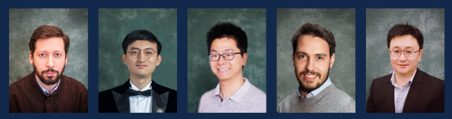
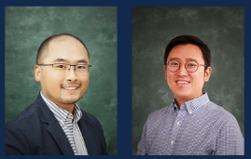
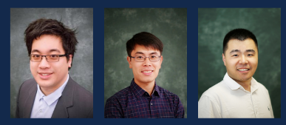
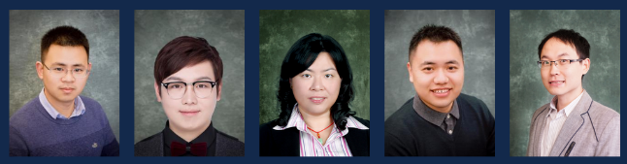
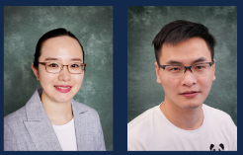
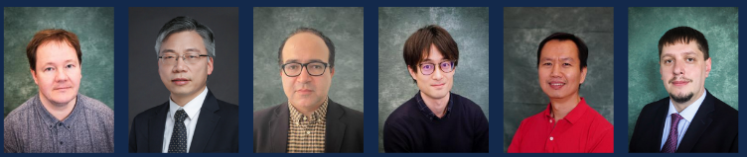
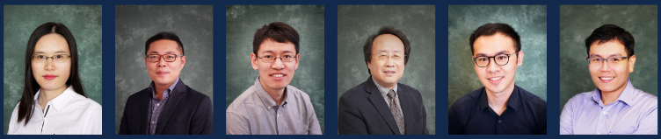
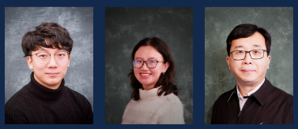
Letters of Recommendation
Letters need to be from someone in a suitable position who knows you well and can discuss why you will be a strong addition to a research team.
The best letters are from a professor who knows you well and has had you working in a lab or on a project.
Good letters can also come from a supervisor for an industry internship.

Slide 13
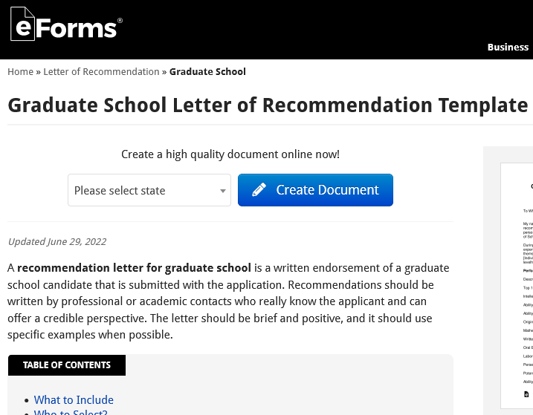
Letters of Recommendation
Form letters or student-drafted letters signed by famous people are likely to be ignored or discarded. They can even get you rejected.
Letters from friends or family have little value.
AI tools and online
forms are not an
acceptable
strategy

Slide 14
Personal Statement
Personal statements might say:
  Why you are interested in graduate school.
  What you would like to work on and study.
  How you will work to be successful.

Slide 15
Weak examples
“I’ve always wanted to be an engineer.”
“I am the best student at my school.”
“I have achieved a high GPA.”
“You are a famous professor and I want to work with you.”
Please do not do these. I do not care what Internet advice you have found.

Slide 16
Stronger examples
“I gained experience in software engineering and real-time systems during a summer internship and a campus lab project, and want to learn much more about these topics.”
“I was a leader of our campus robotics team. We competed at the national level. Even though my interests are broader than robotics, I want to study much more deeply in controls.”

Slide 17
Stronger examples
“A research project exposed me to challenges in biomedical engineering, and I hope to apply my background and learn more.”
“I believe that machine learning will change a lot in the next few years as we learn how to use much larger datasets and inform data with physical models. I want to be a part of this excitement.”

Slide 18
Can you see the theme?
These short statements talk about why you want to go to graduate school.
Be very careful using things like ChatGPT. They learn from common bad examples in addition to rarer good examples.
AI results for statements and forms tend to be well below average because of this learning process.

Slide 19
Underlying issue
For jobs and for graduate schools, the work is about relationships, people, and environment.
Would you want to work in this place, with these people?
There are interesting opportunities in many, many places.
Ranks of companies and schools have much less meaning than personal relationships.

Slide 20
Working for “famous people”
One problem is that many students seek to work with the most famous people, attend the most famous schools, or work for the most famous companies.
This might or might not be the best way to learn, grow, and meet your own expectations.
What is the nature of the work?
Who will you actually work with or work for?
Better to work with a new professor and help make that person famous than to work an hour a month with a famous person.

Slide 21
“Famous”
“Most famous” is not the same as “most important” or “most creative.”
“Most famous” often has little to do with “best.”
Even Nobel prizes typically link to work done decades in the past.
Being engaged in a program that is highly motivating and exciting is much more important than a program where everyone knows the name.

Slide 22
What about rankings?
QS rankings are weakly supported:
  They survey faculty and ask them to mention schools.
  They do not ask for ordering, for specific areas of excellence, or for future promise. Just a list.
US News rankings:
  These try to be objective.
  However, most people agree that the factors and weights are not the right ones.

Slide 23
What about rankings?
In North America, these mean that rankings must be considered in “groups” or “tiers” rather than in numerical order.
Example: in engineering, broadly, the top tier includes MIT, Illinois, Berkeley, Stanford, and Carnegie Mellon.
The order does not matter within a tier, and varies a lot among specific topics in any case.

Slide 24
What about rankings?
Even that is misleading.
Broadly, schools listed as “top 50” have many strengths.
Even “lower” schools have important areas of strength.
There are more than 300 ABET accredited schools in the U.S., and the majority have graduate programs.

Slide 25
How to match and learn strength areas?
Your professors are an excellent resource for helping you identify specific programs.
They know quite well where the best programs and faculty are in their areas of interest.
True at ZJUI, at UIUC, and also for many people at ZJU.

Slide 26
What about the application process?
Ask for advice. Professors and tutors can give suggestions on personal statements and resumes.
Apply. Do it before the deadlines.
Provide your references with a copy of your personal statement and resume.
Give letter writers enough time. Most of them will need a few weeks.
Make sure the materials are complete, in place, and on time.

Slide 27
During the process
If you really do have contact or personal connections with a faculty member, an email telling them you have applied and are interested is OK. You can invite a phone call or Zoom.
Be patient. Very few places will contact you before February. Most wait until March.
Many schools invite some applicants for a visit day. Many schools now have a “virtual visit day.”
U.S. schools all give students until April 15 to accept an offer. Read the offer, contact faculty linked to the offer.
Make your decision with care, respond by the deadline.

Slide 28
Some other questions
What are requirements for application to UIUC MEng programs?
  Find the web sites: https://mechanical.illinois.edu/graduate/master-engineering-mechanical-engineering
  https://www.cee.illinois.edu/academics/graduate-programs/professional-ms-program
  https://ece.illinois.edu/academics/grad/overview/meng.asp
  https://cs.illinois.edu/academics/graduate/professional-master-computer-science

Slide 29
Some other questions
More information about US university deadlines and programs?
  If we have faculty at ZJUI or ZJU in the areas of your interest, ask them about interesting programs.
  Find the web sites.
  Keep in mind that some information is not up to date.
M.S., Ph.D., M. Eng? Boundaries? Choices?
  The traditional programs are M.S. followed by Ph.D. Choose this or direct Ph.D. if you seek a doctorate.
  M.Eng. is usually for people planning an industry career who want to get specialized knowledge quickly.

Slide 30
Some other questions
In U.S. industry, masters’ degrees are treated as equivalent (no distinctions among M.S., M.Eng., others). Less true in China.
How to demonstrate English proficiency? Best is to arrange a personal phone conversation or Zoom meeting.
Connections around the world?
  Take advantage of UIUC exchange.
  If you can, try to arrange in-person visits to some schools.
  Are there specific summer programs you can access?

Slide 31
One more point
When you are a graduate student in North America, it is taken for granted that you are responsible, honest, and self-motivated.
  Attend class!
  Be on time to classes, meetings, events!
  Your professors will expect you to prepare and submit work without being reminded and with general guidance rather than detailed instructions.
  Plan ahead.
  Be involved, and seek out leadership opportunities (IEEE, ASME, ASCE, team projects, outside activities).

